Slide 1
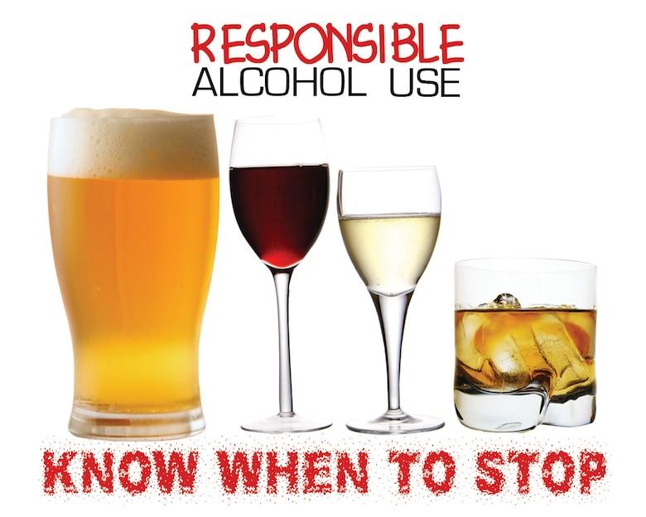
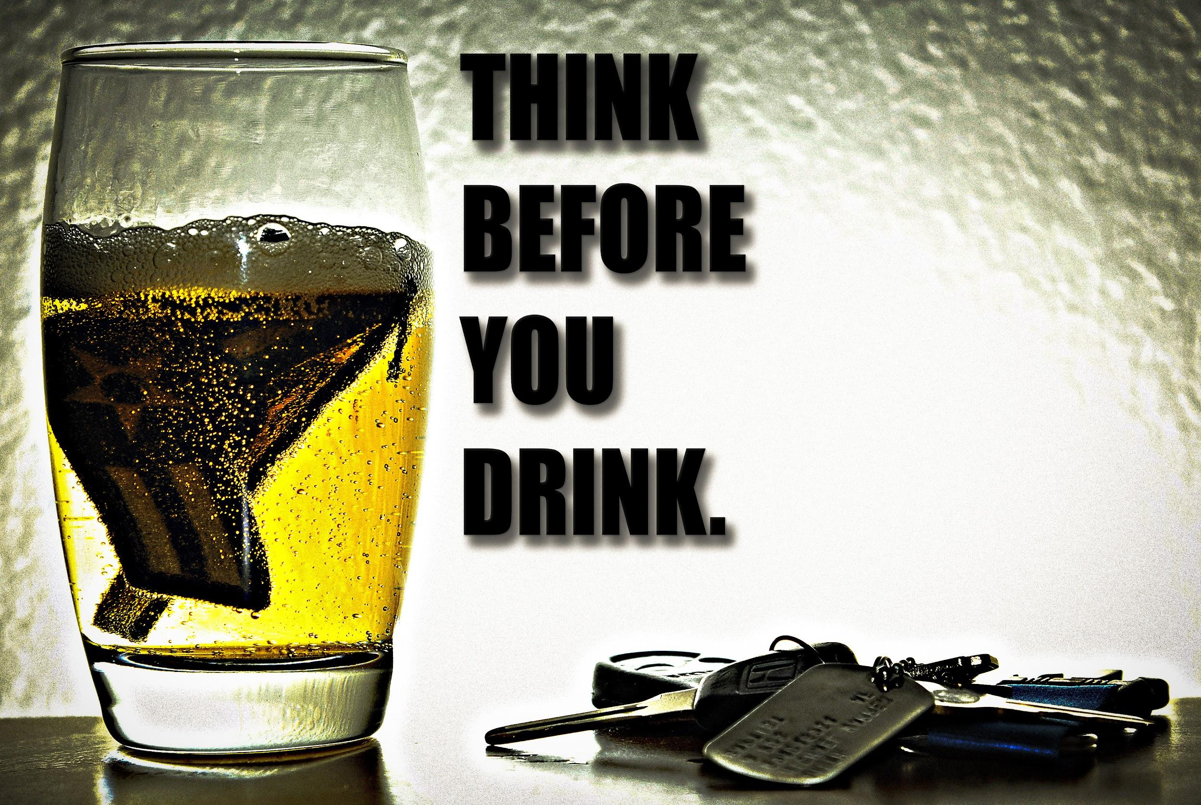
Alcohol Consumption & Suicide Rates

Slide 2
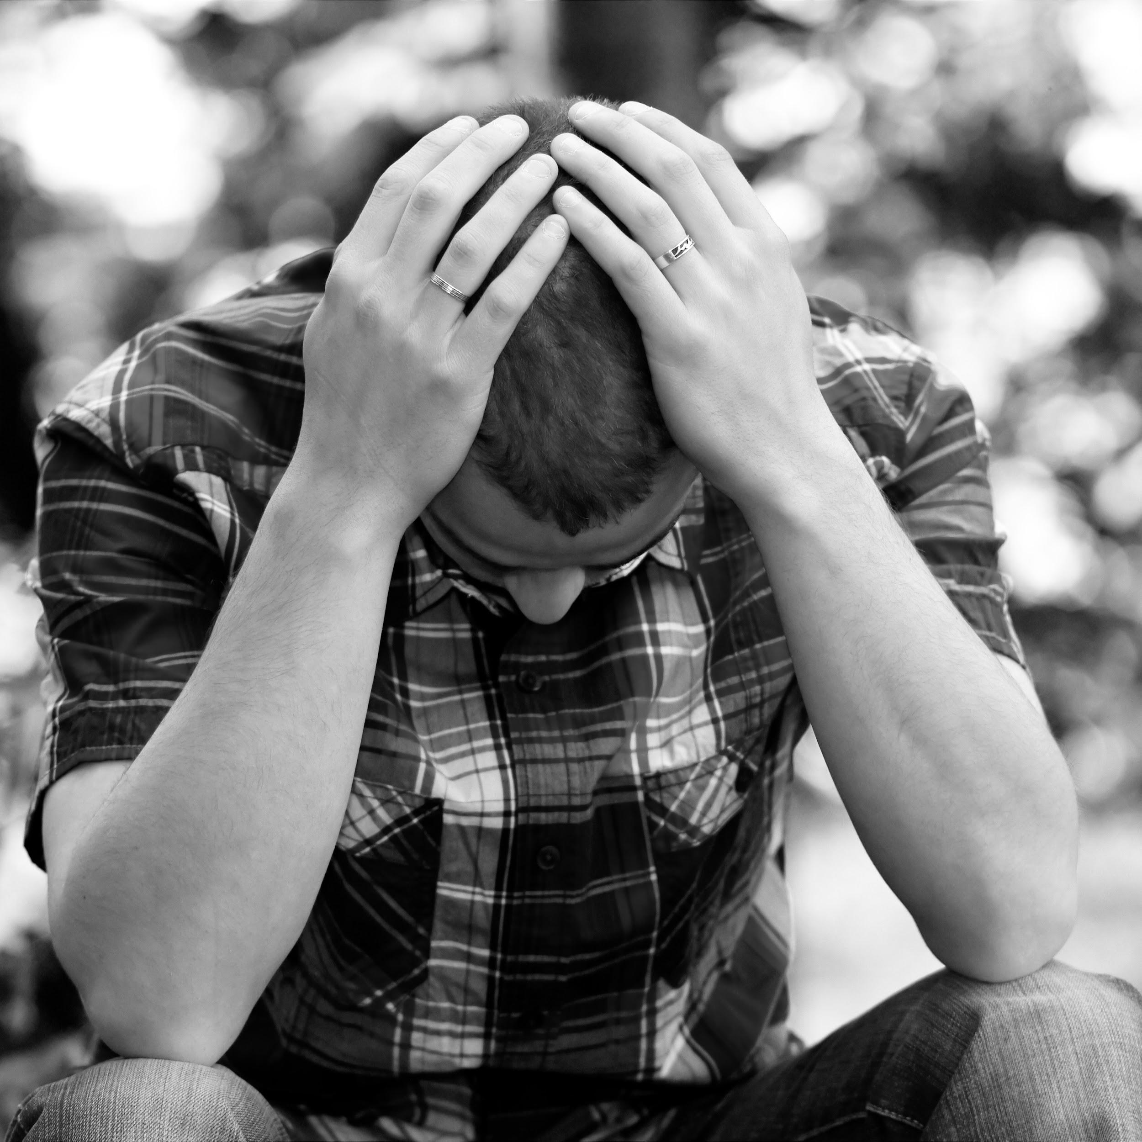
The Issues with Mental Health and “Self-Medication”
Mental health and substance abuse disorders affect 13% of the world’s population
Covid-19 caused almost 60% of people in the US alone to be mentally affected
Suicide is the 10th leading cause of death of all ages - with 1 death by suicide every 11 minutes in the US
Most people who attempt and commit suicide have a diagnosable mental disorder
Majority of adults generally self-medicate in order to save time, money, and trips to the doctor and consider it a “quick fix”
The oversight, belittlement, and stigmatization of mental health leads many to think they can solve the issues themselves as it is just “mental”
Notes:
Citations:
SingleCare Team. (2021, January 21). Mental health statistics 2021. The Checkup. Retrieved December 5, 2021, from https://www.singlecare.com/blog/news/mental-health-statistics/.
Ba, A. (2008, March 19). New Data Suggest That Despite Knowing the Risk of Self-Medication, 76 Percent of American Adults Use Non-Prescription Medications for Themselves and Their Children. "wait, educate before you self-medicate". Retrieved December 5, 2021, from https://www.news.sanofi.us/press-releases?item=118316.
John Hopkins Medicine. (n.d.). Mental health disorder statistics. Johns Hopkins Medicine. Retrieved December 5, 2021, from https://www.hopkinsmedicine.org/health/wellness-and-prevention/mental-health-disorder-statistics.

Slide 3
Helping Humanity Find Better Resources and Solutions
Is self-medicating more detrimental than affective?
How does alcohol consumption affect mental health and the rate of suicides?
What is the average difference in suicide rates in countries with higher alcohol consumption versus countries with lower alcohol consumption?

Slide 4

The Data Analysis
Alcohol Consumption Data
Total of 82 countries with high alcohol consumption rates (>= 6.0 liters) versus 80 countries with low alcohol consumption rates (<6.0+ liters)
While alcohol consumption rate ranged from 0.03 to 23 liters per capita, 6.0 liters was used as the threshold instead of the middle ground rate of 11.5 due to the fact that majority ranged more so between 0.03 to around 15
Data includes alcohol consumption rates, income and employment rates, suicide rates, and urban rates by country

Slide 5
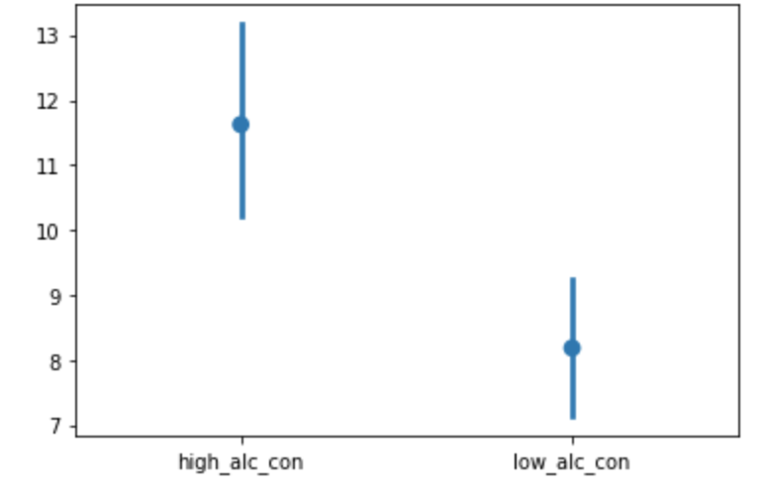
The Statistical Significance
We can visually see that countries with higher alcohol consumption have significantly higher rates of suicide
With 95% confidence, countries with lower alcohol consumption have on average 1.6-5.3 less suicide rates per 100th.

Slide 6
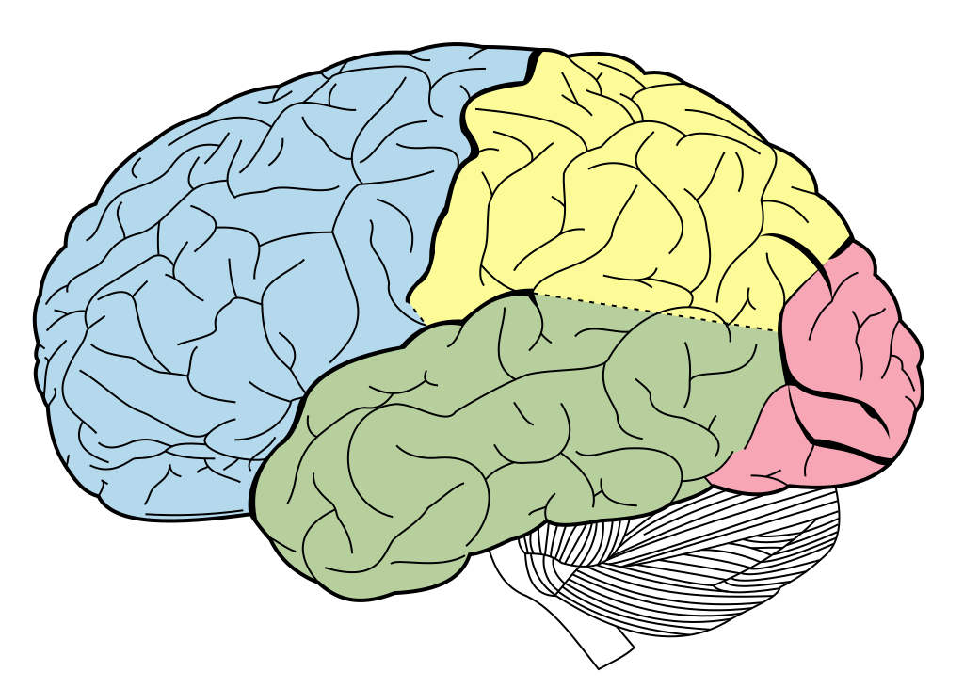
We Have to Bring Awareness to Self-Medicative Solutions
Issues of the brain must be addressed in a more serious manner
Mental disorders are essentially brain disorders and need professional health
Mental illness impacts how a person thinks/behaves and alcohol does not solve the problems directly
Alcohol awareness and the implications it can cause
The uniqueness of every person’s brain and what it needs and doesn’t need

Slide 7

Focus More on Mindful Practices
Alcohol cannot make problems go away - it only creates more
Learning how to face one’s own predicaments rather than self-medicating with substances
Raising the commonality of mental issues and getting help
Making mental health more accessible
Annual mental health check up alongside annual health check ups

